Slide 1
Welcome Everybody

Slide 2
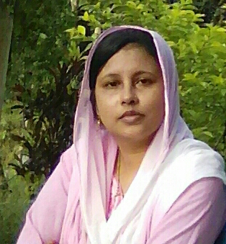
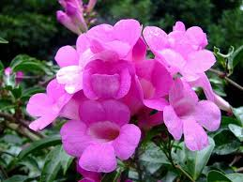
Rafeya Akter Happy
Assistant Teacher
A.M.Government Primary School
Hatiya,Noakhali
Class:Three
Subject:English
Lesson(1-2) occupations
Unit:19
Time:45 minutes

Slide 3
Let’s watch the video
What do you see in the video?
What today’s lesson might be?

Slide 4
Todays lesson is----
Occupations

Slide 5
Learning outcomes-------
Students will be able to-----
repeat words after the teacher with proper sound,stress and intonation.
spell four words and use in sentences.
read and match words with pictures
talk about people.

Slide 6
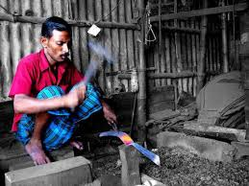
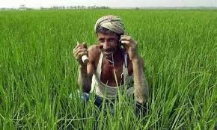
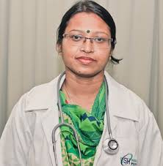
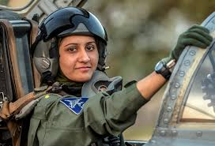
Who are these people?
What do they do?

Slide 7
Let’s listen my audio

Slide 8
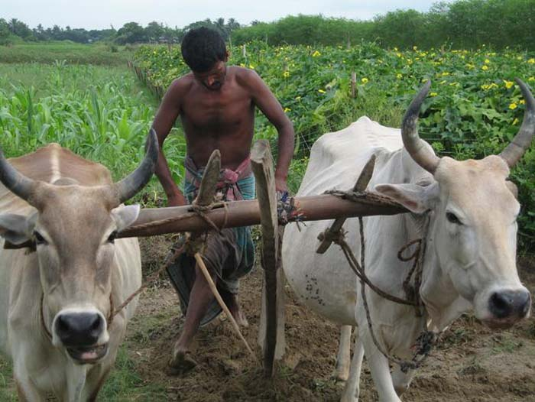
Look at the pictures please then write the name of the occupations on your khata(gw).

Slide 9
Let’s listen my another audio.

Slide 10
Open at page 38
B.Read and match with the picture.Write the correct number in the box(pw).
A farmer grows food
A doctor helps people
A pilot flies a plane
A blacksmith makes metal things.
3
4
1
2

Slide 11
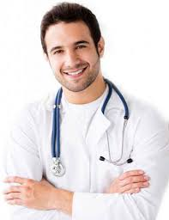
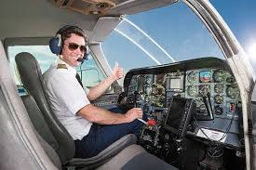
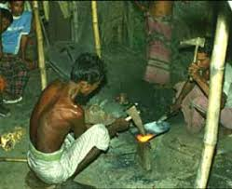
New words (by using pictures)
Word
Word meaning
A person who cultivate crops
Farmer
A person who gives treatment
Doctor
A person who controls an aircraft
Pilot
A person who makes things in iron by hand
Blacksmith

Slide 12
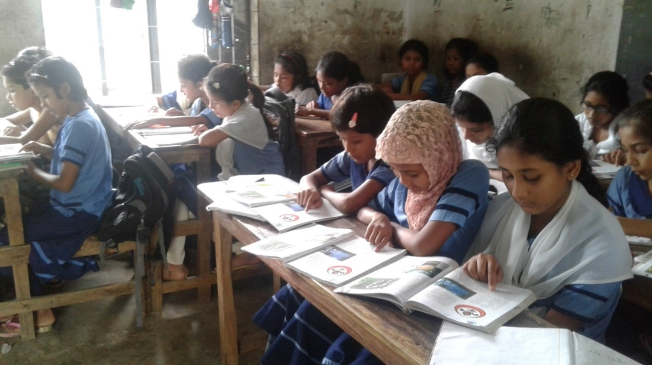
Silent Reading

Slide 13
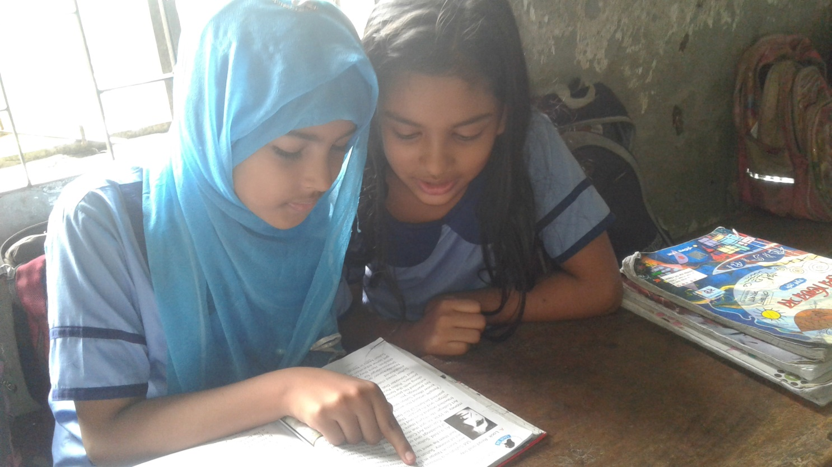
One read and another listen(pw)
Time:5 minutes

Slide 14
Evaluation
Answer the questions
What does a farmer do?
What does a pilot do?
What does a blacksmith do?
What does a doctor do?

Slide 15
Thanks a lot
See you

